Slide 1
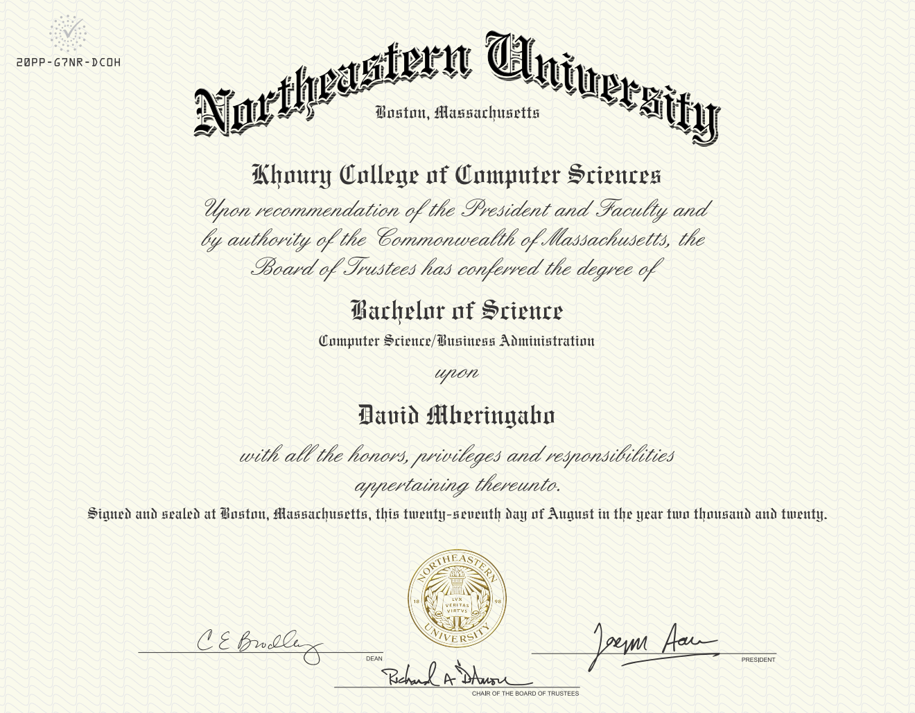
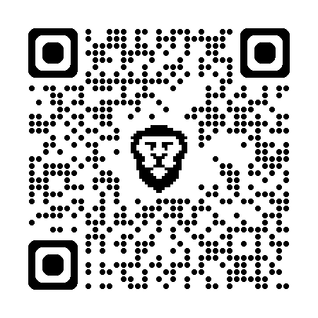
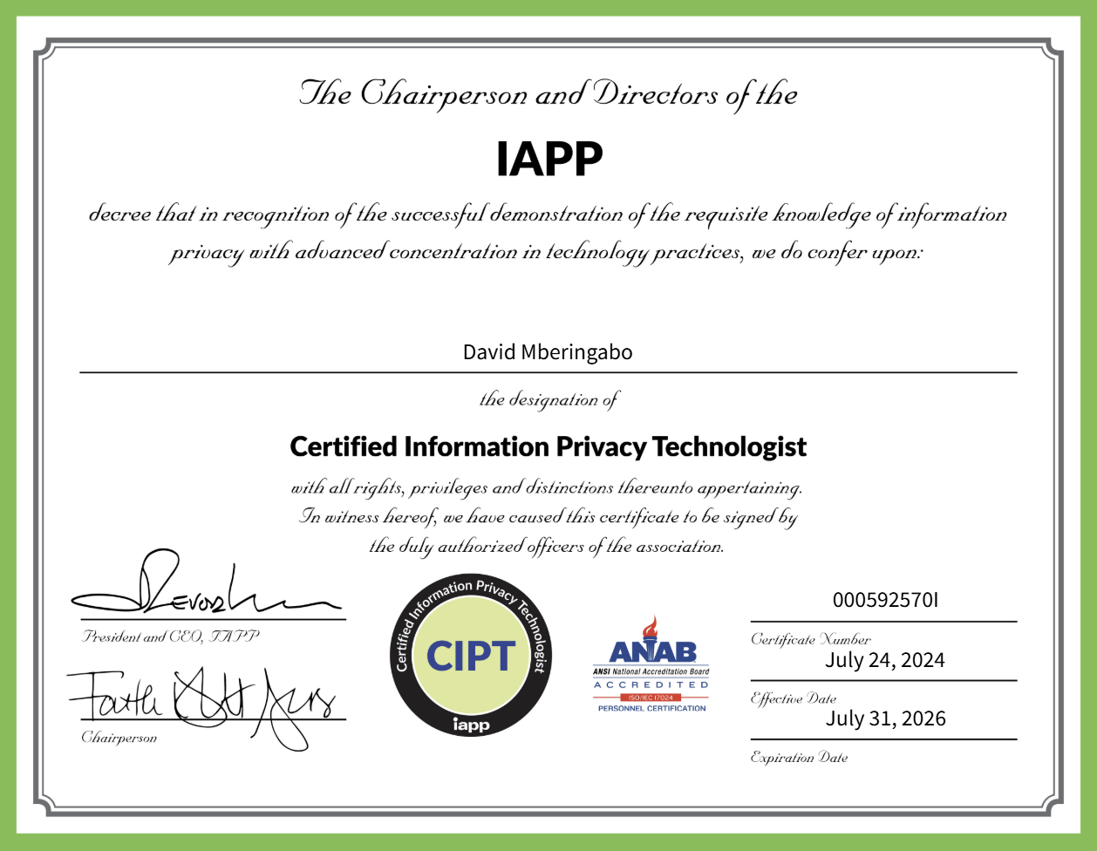
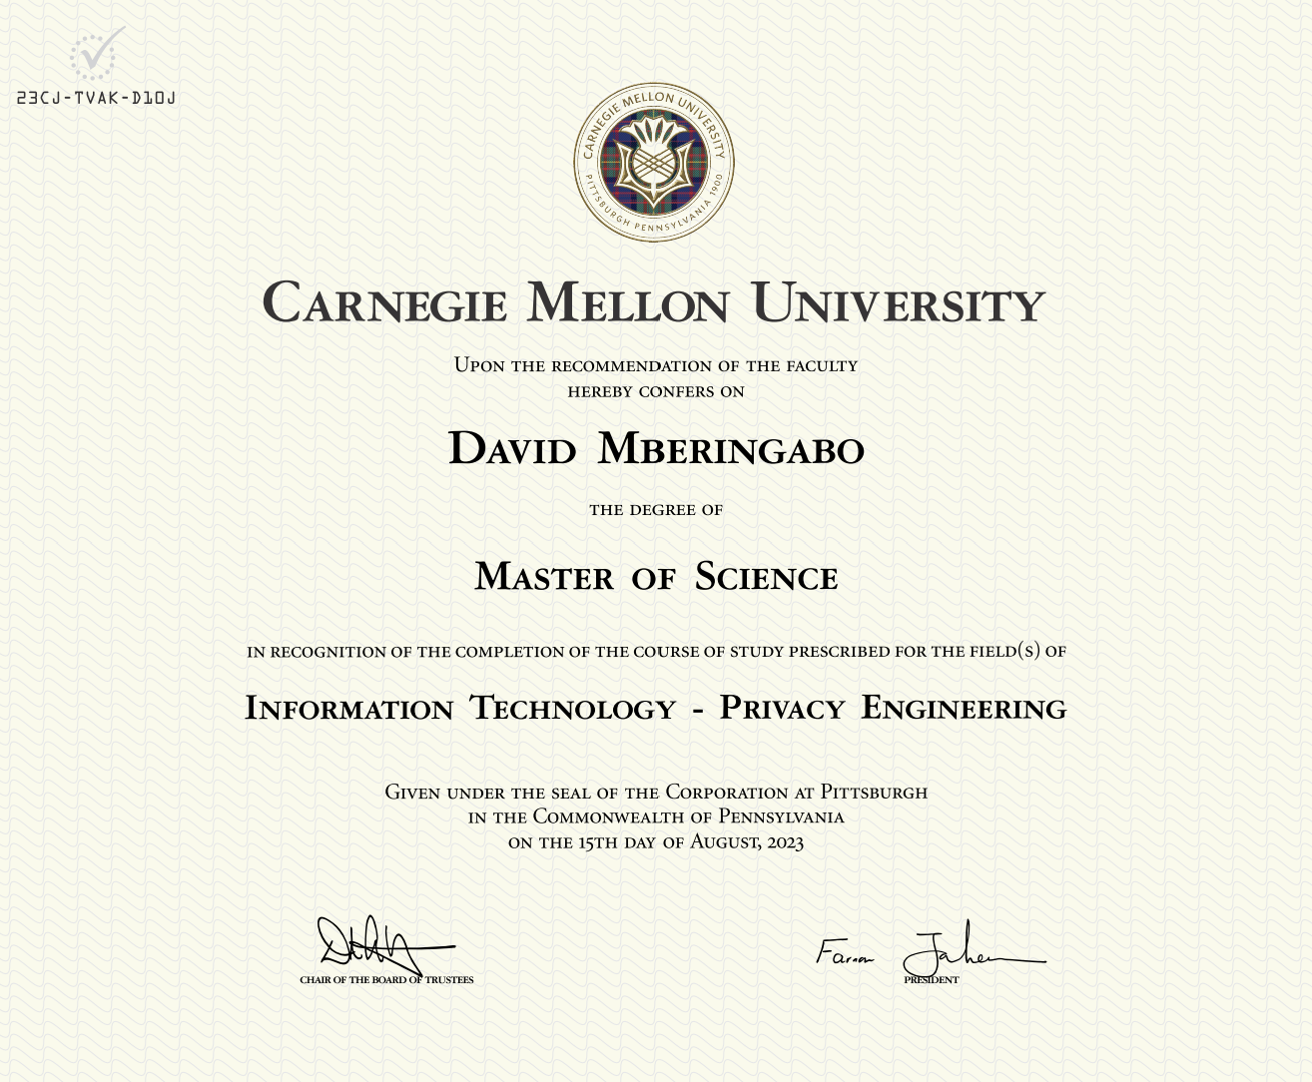
PhotoGnark
By David Mberingabo
Gnark-based implementation of PhotoProof by Assa Naveh and Eran Tromer
https://github.com/drakstik/PhotoGnark_ACDF
Notes:
[1] 15-799: Security for Software and Hardware Systems (https://www.cs.cmu.edu/~15799/schedule.html)“

Slide 2
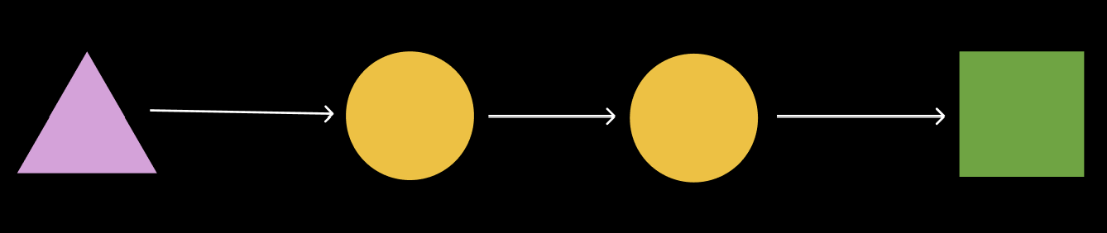

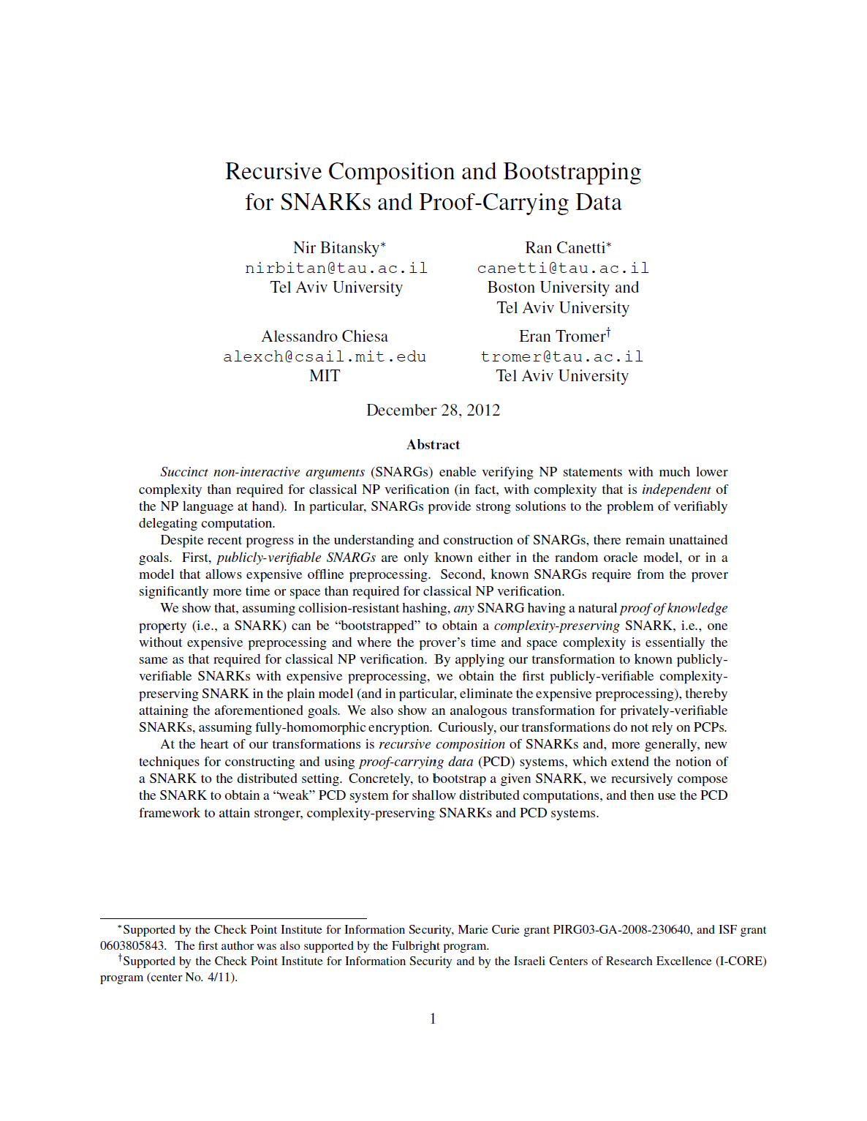
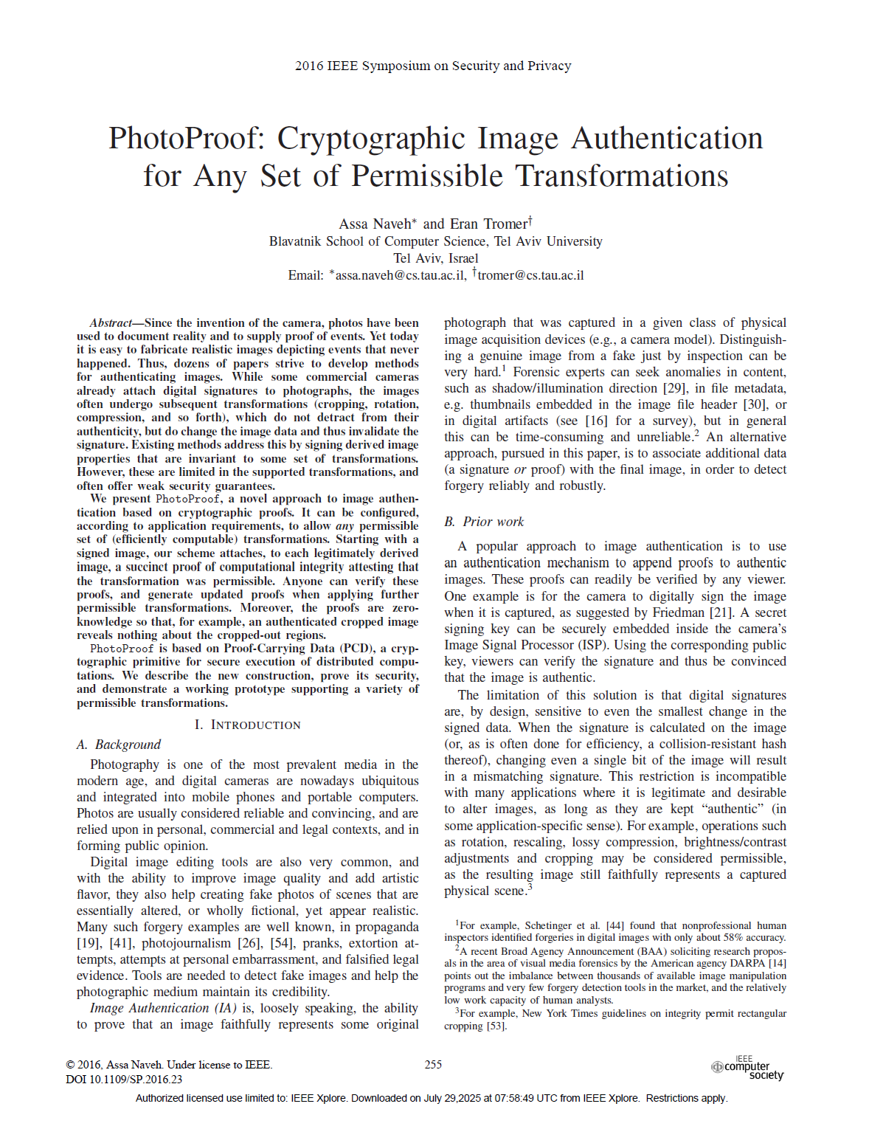
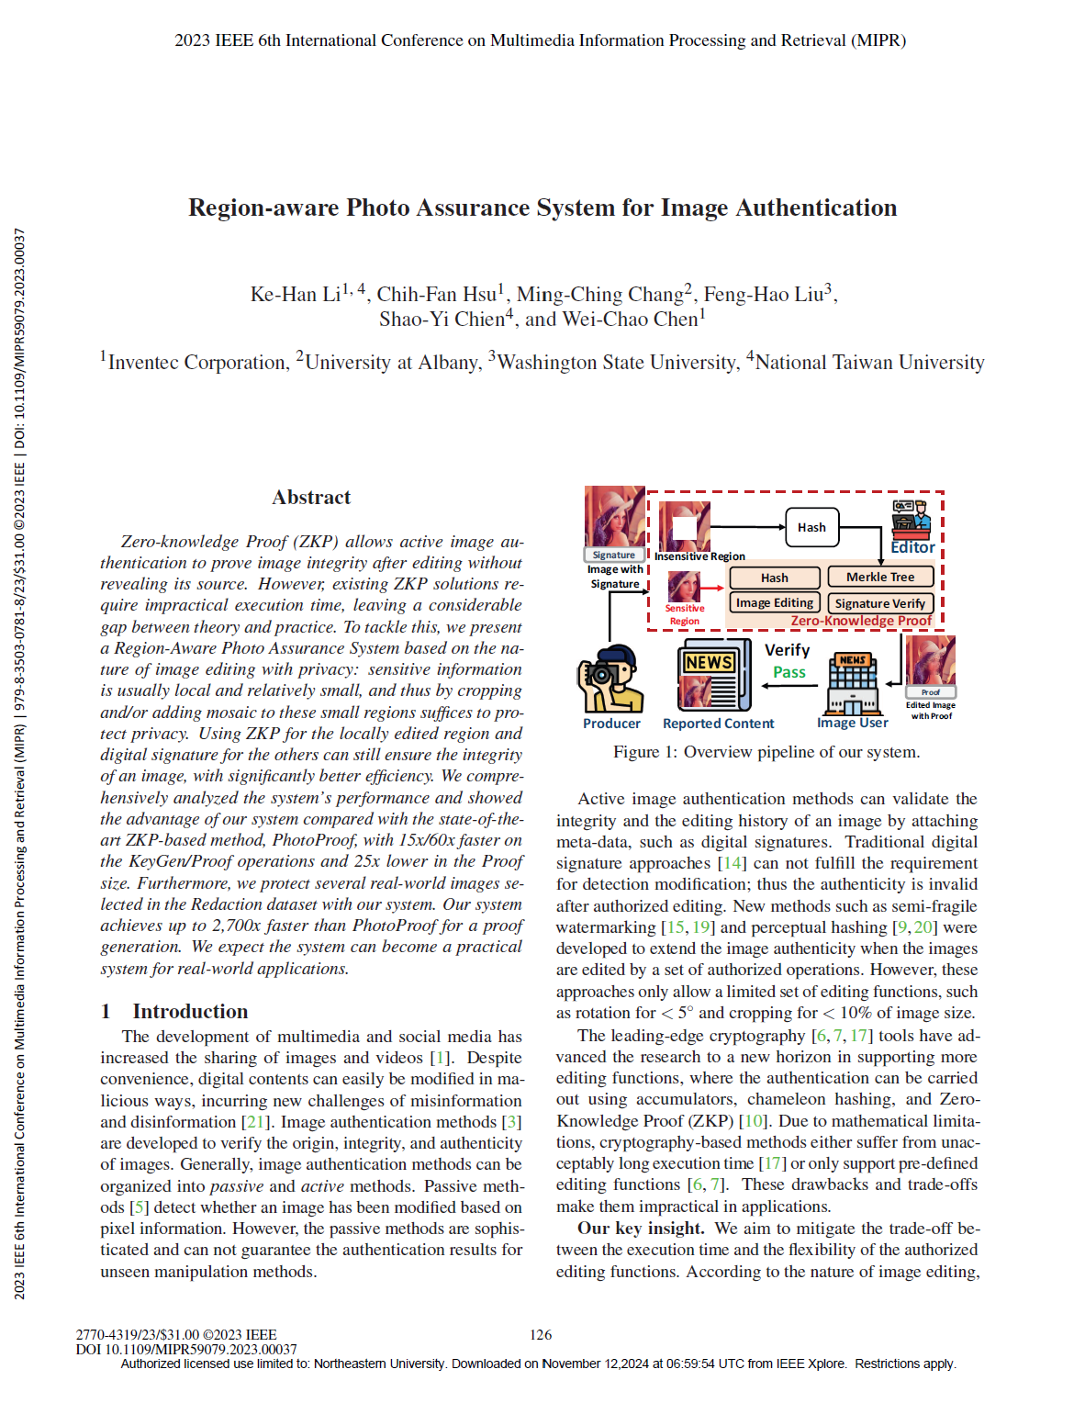
Content
Zk-SNARKs
Where is it used?
Arithmetic Circuits
Argument of Knowledge
Gnark
What is it?
Hashing example
Signature example
Limitations
Image Authentication – PhotoProof
Images Forgery and Authentication
PhotoProof
Limitations & Next Steps

Slide 3
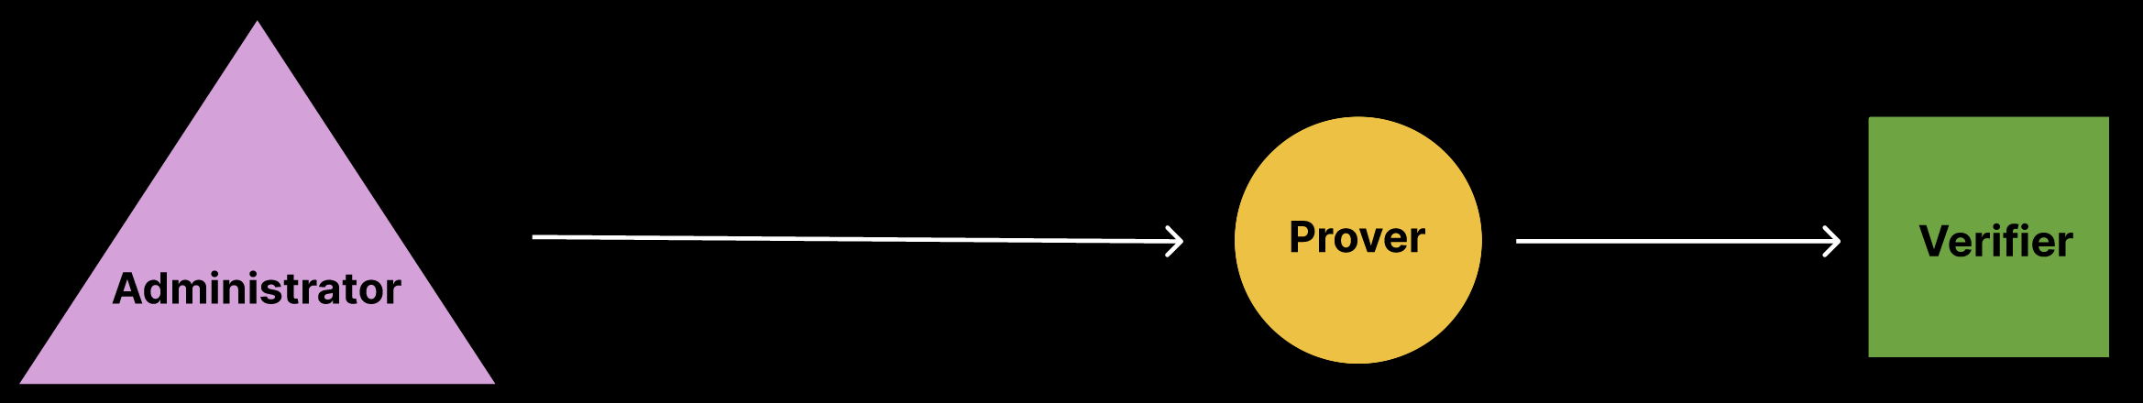
ZK-SNARKs
Zk-SNARK stands for:
Zero-Knowledge: ???
Succinct: ???
Non-interactive: ???
Argument of Knowledge: ???
Proof that a Prover has knowledge of a secret input to a computation (a program, circuit, or polynomial equation).

Slide 4
ZK-SNARKs
Zk-SNARK stands for:
Zero-Knowledge: Prover’s local data remains secret
Succinct: ???
Non-interactive: ???
Argument of Knowledge: ???
Proof that a Prover has knowledge of a secret input to a computation (a program, circuit, or polynomial equation).

Slide 5
ZK-SNARKs
Zk-SNARK stands for:
Zero-Knowledge: Prover’s local data remains secret
Succinct: Fast verification time
Non-interactive: ???
Argument of Knowledge: ???
Proof that a Prover has knowledge of a secret input to a computation (a program, circuit, or polynomial equation).

Slide 6
ZK-SNARKs
Zk-SNARK stands for:
Zero-Knowledge: Prover’s local data remains secret
Succinct: Fast verification time
Non-interactive: No interaction between the Prover & Verifier
Argument of Knowledge: ???
Proof that a Prover has knowledge of a secret input to a computation (a program, circuit, or polynomial equation).

Slide 7
ZK-SNARKs
Zk-SNARK stands for:
Zero-Knowledge: Prover’s local data remains secret
Succinct: Fast verification time
Non-interactive: No interaction between the Prover & Verifier
Argument of Knowledge: ???
Proof that a Prover has knowledge of a secret input to a computation (a program, circuit, or polynomial equation).

Slide 8
Zk-SNARKs – Where is it Used?
The largest and most widely adopted zk-SNARK infrastructures today are:
Ethereum Layer 2 rollups^{[1]}
Privacy and lightweight chains
Emerging apps and developers
Currently over $3.5 Billion in value
Infrastructure | Estimated TVL
Starknet (Gaming)^{[2]} | ~$629 million
zkSync Era (Banking & Finance) | ~$610 million → ~$1.36 billion → ~$2.03 billion
Manta Network (DeFi, Binance^{[3]}) | ~$55 million → ~$851 million → ~$1.5 billion
Other zk-SNARK Rollups | ~$1.3 billion aggregate
Notes:
[1] https://hacken.io/discover/zk-rollups-explained/
[2] https://www.starknet.io/blog/starknet-ecosystem-report-2025/
[3] https://www.binance.com/en/blog/tech/6654580406550811626

Slide 9
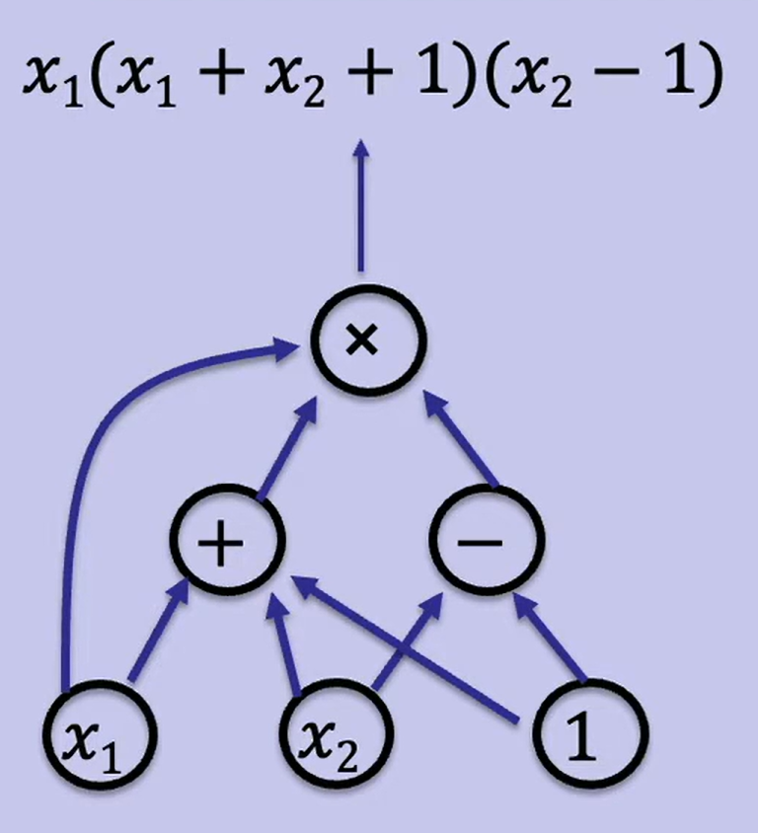
Zk-SNARK – Arithmetic Circuits
An Arithmetic Circuit C is simply “a function that takes inputs from the finite field F and returns a single output value from F”, where a finite field F is some number {0, …, p - 1} for some prime p > 2.
We can say that a circuit C is defined as C(x₁, x₂) = x, where x₁ and x₂ are inputs to the circuit and x is the output.
This graph represents a circuit’s gates, with variable inputs x₁, x₂ and the constant input 1.

Slide 10
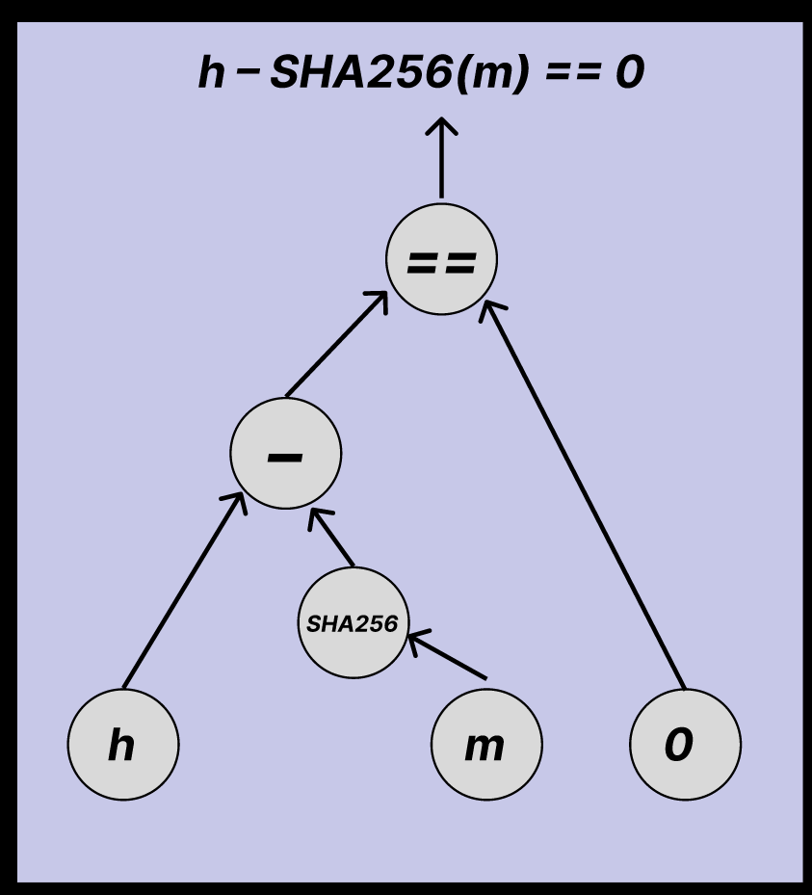
Zk-SNARK – Arithmetic Circuits
Consider hash(h,m) = (h – SHA256(m)), where h is some hash and m some message.
This circuit outputs 0 if SHA256(m) == h, and SHA256(m) != 0.
Inputs are h, m and 0
Many gates
This graph represents a circuit’s gates, with variable inputs h, m and the constant input 0.

Slide 11
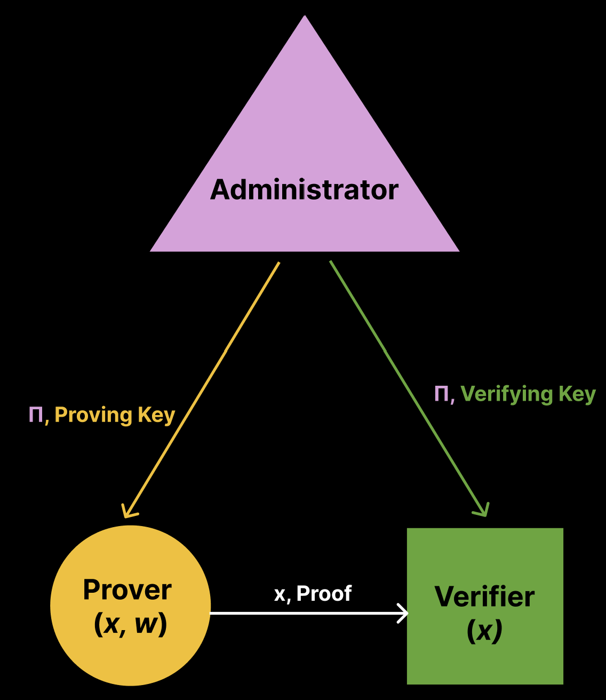
Zk-SNARK – Argument of Knowledge
Proving Key -- the Prover can create a proof that they know an x and w which fulfills a certain circuit.
Verifying Key -- the Verifier can verify the proof and be convinced that the Prover knows some secret input w and some public input x, such that C(x,w) = 0, where C is an arithmetic circuit.

Slide 12
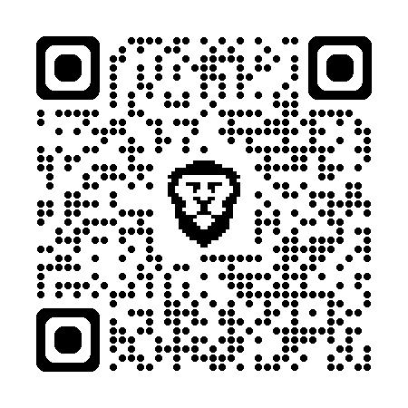
Zk-SNARK – Requirements
*Scan for more info on zk-SNARK
Zero-Knowledge
The proof of knowledge reveals nothing about secret input w
Succinctness
Proof size and verification time are logarithmic to the size of the circuit
Non-Interactive
Single proof is required, instead of multiple interactions
Argument of Knowledge
If the Verifier accepts the proof, then the Prover “knows” the secret input w
If a malicious prover does not know w, the Verifier will accept that proof with negligible probability
Completeness
If w fulfills the circuit, then the Verifier will accept the proof of knowledge

Slide 13
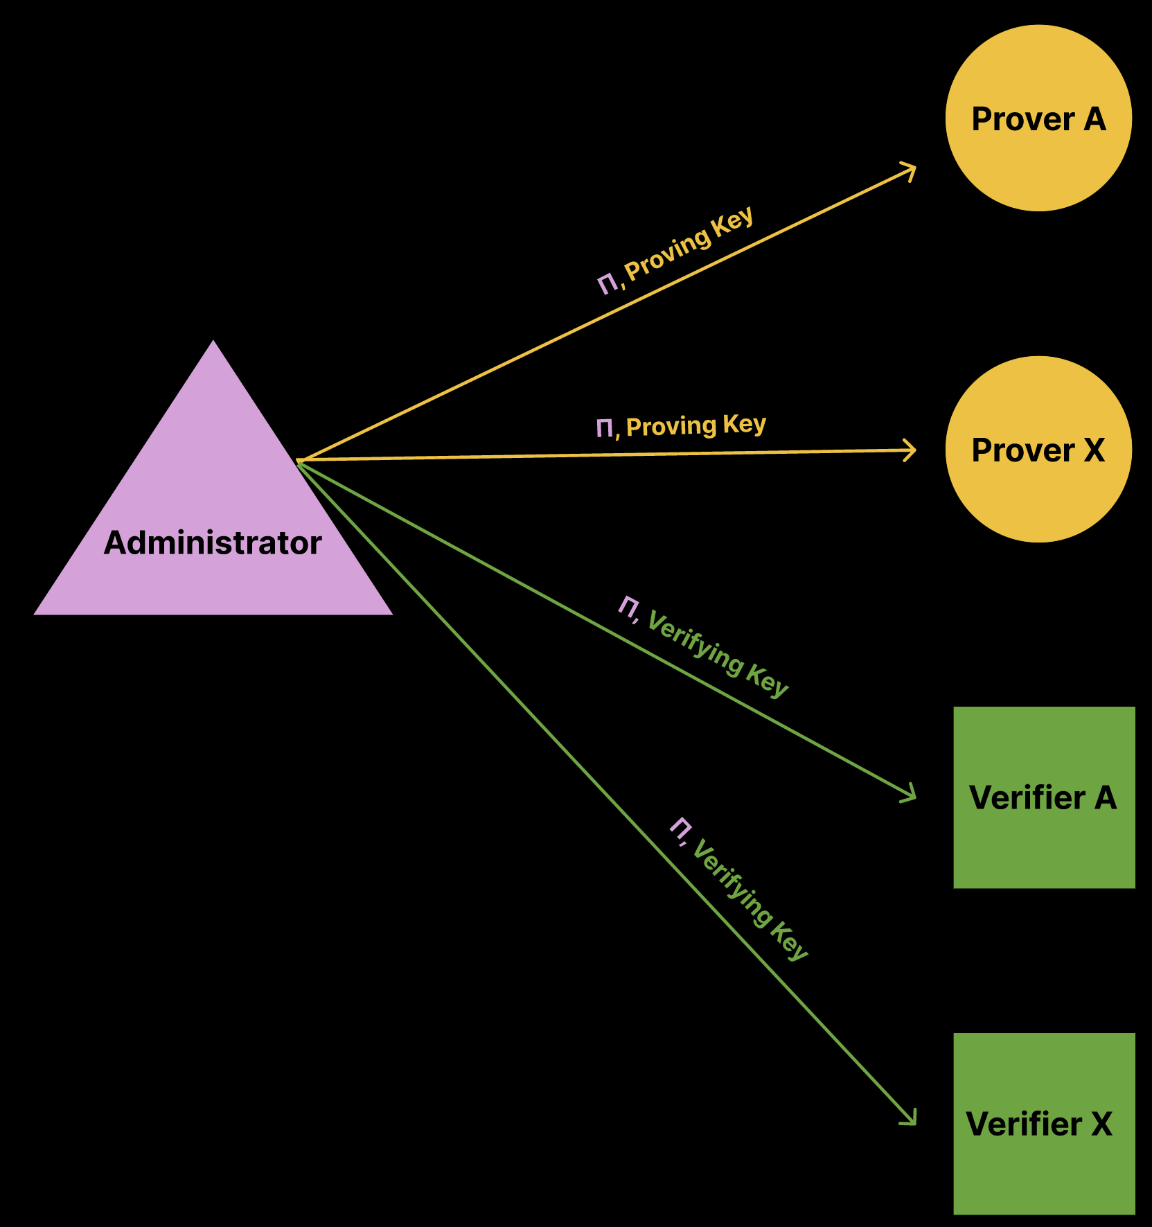
Zk-SNARK – Step 1
Admin: Defines a circuit C, and uses C to generate & share Proving & Verifying Keys
Let Π be a Compliance Predicate,
e.g. C(x,w) = (h – SHA256(m)), such that C(x,w) = 0

Slide 14
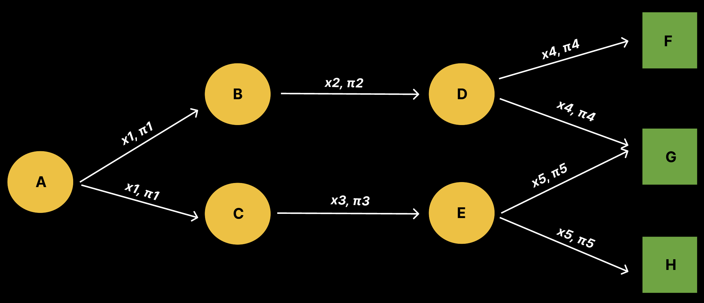
Zk-SNARK – Step 2 & 3
Prover: Create a proof, using secret knowledge and proving key
Verifier: Verify the proof, using public knowledge and verifying key
Let x be a public input to a circuit and let π be a Zk-SNARK proof.
At each hop, a proof can be generated using local inputs and a Proving Key.
At each hop, the proof can be verified using the public inputs and a Verifying Key.

Slide 15


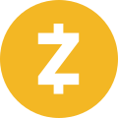

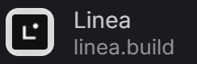
Gnark – What is it?
A Golang package for Zk-SNARKs
Open source
Offers a high-level API to design circuits
Developed by Consensys,
Ethereum,
MetaMask
Ethereum
MetaMask
Zcash
Notes:
[1] https://world.org/blog/announcements/new-world-app-update-slashes-optimism-load-two-thirds

Slide 16
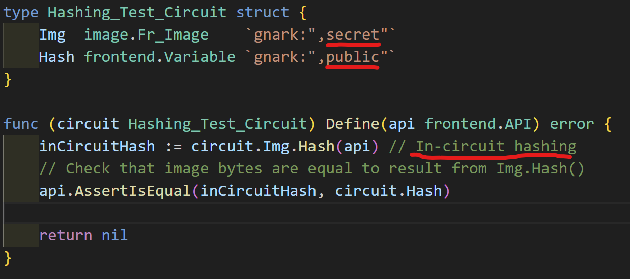
Gnark – Hashing Circuit
Step 1 – Defines a circuit C, and uses C to generate & share Proving & Verifying Keys
This object is the “compliance predicate”:
Public Input → `Hash`;
Secret Input → `Img`
The Define() function does the following:
Secretly hash the secret image
Asserts equality of the Hash input and inCircuitHash
A Prover cannot create a proof unless they know an Img, if Hash(Img) does not equal to the public input.

Slide 17
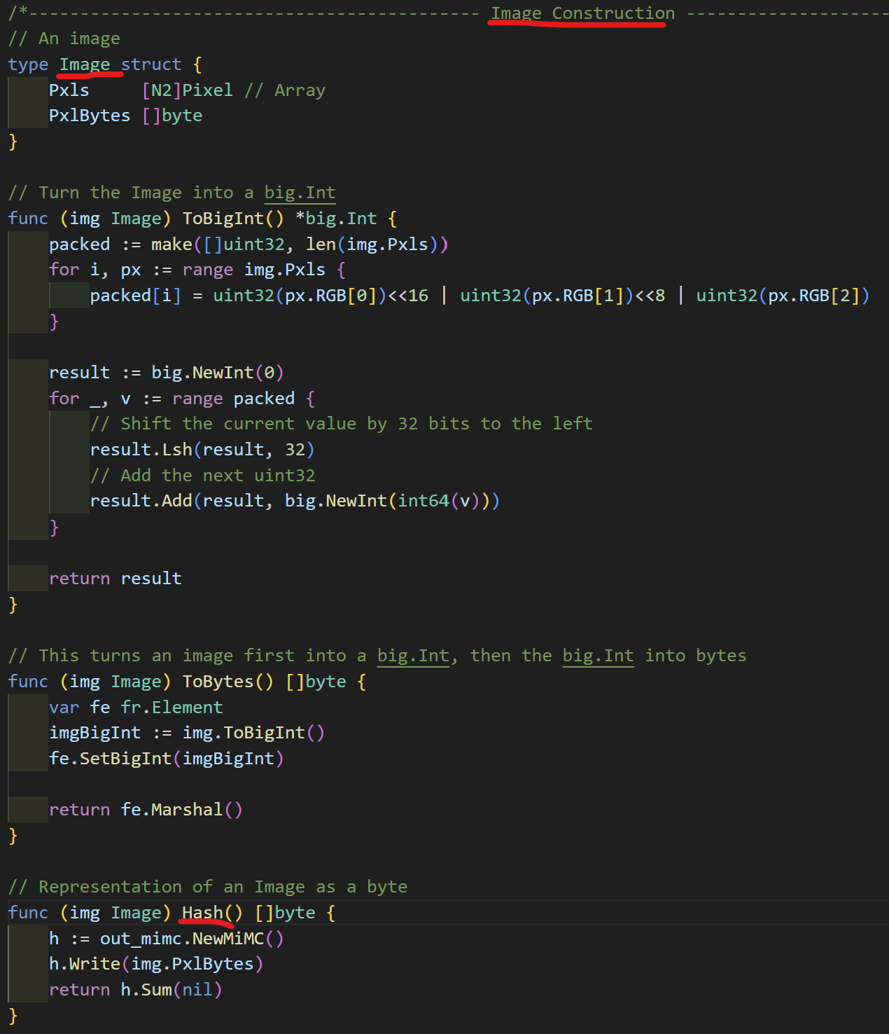
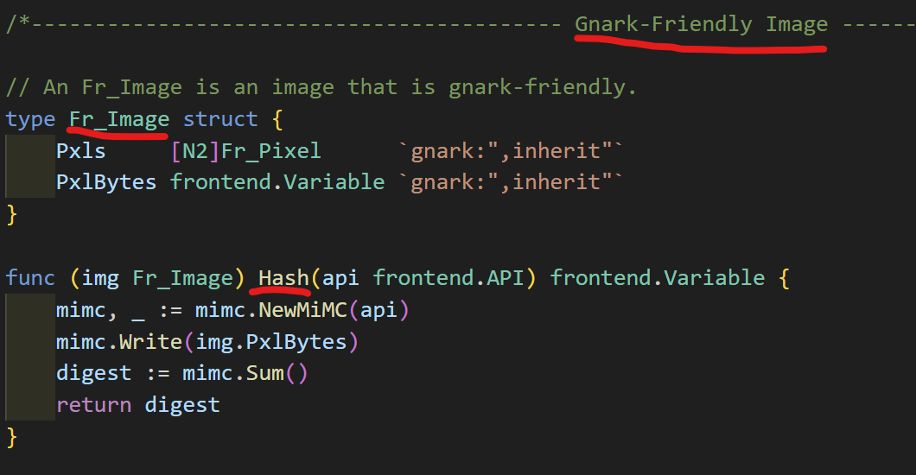
Gnark – Hashing Example
Gnark-friendly vs. normal Golang.
Native Golang types -> frontend.Variable
Gnark provides special MiMC hashing functions to achieve equivalent hashing function for both normal Golang types and Gnark-friendly types like frontend.Variable.

Slide 18
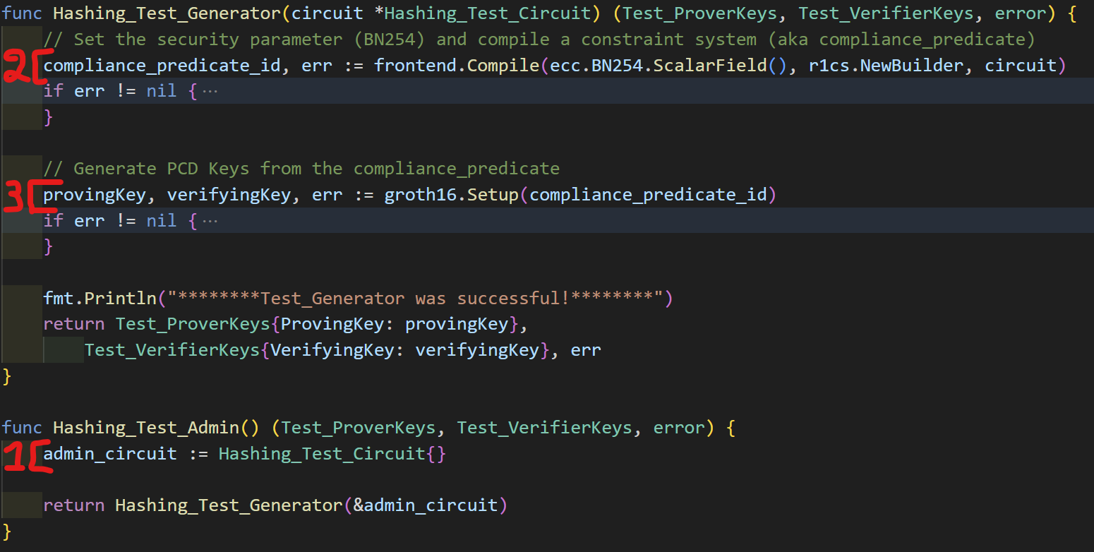
Gnark – Hashing Example
Step 1 – Defines a circuit C, and uses C to generate & share Proving & Verifying Keys

Slide 19
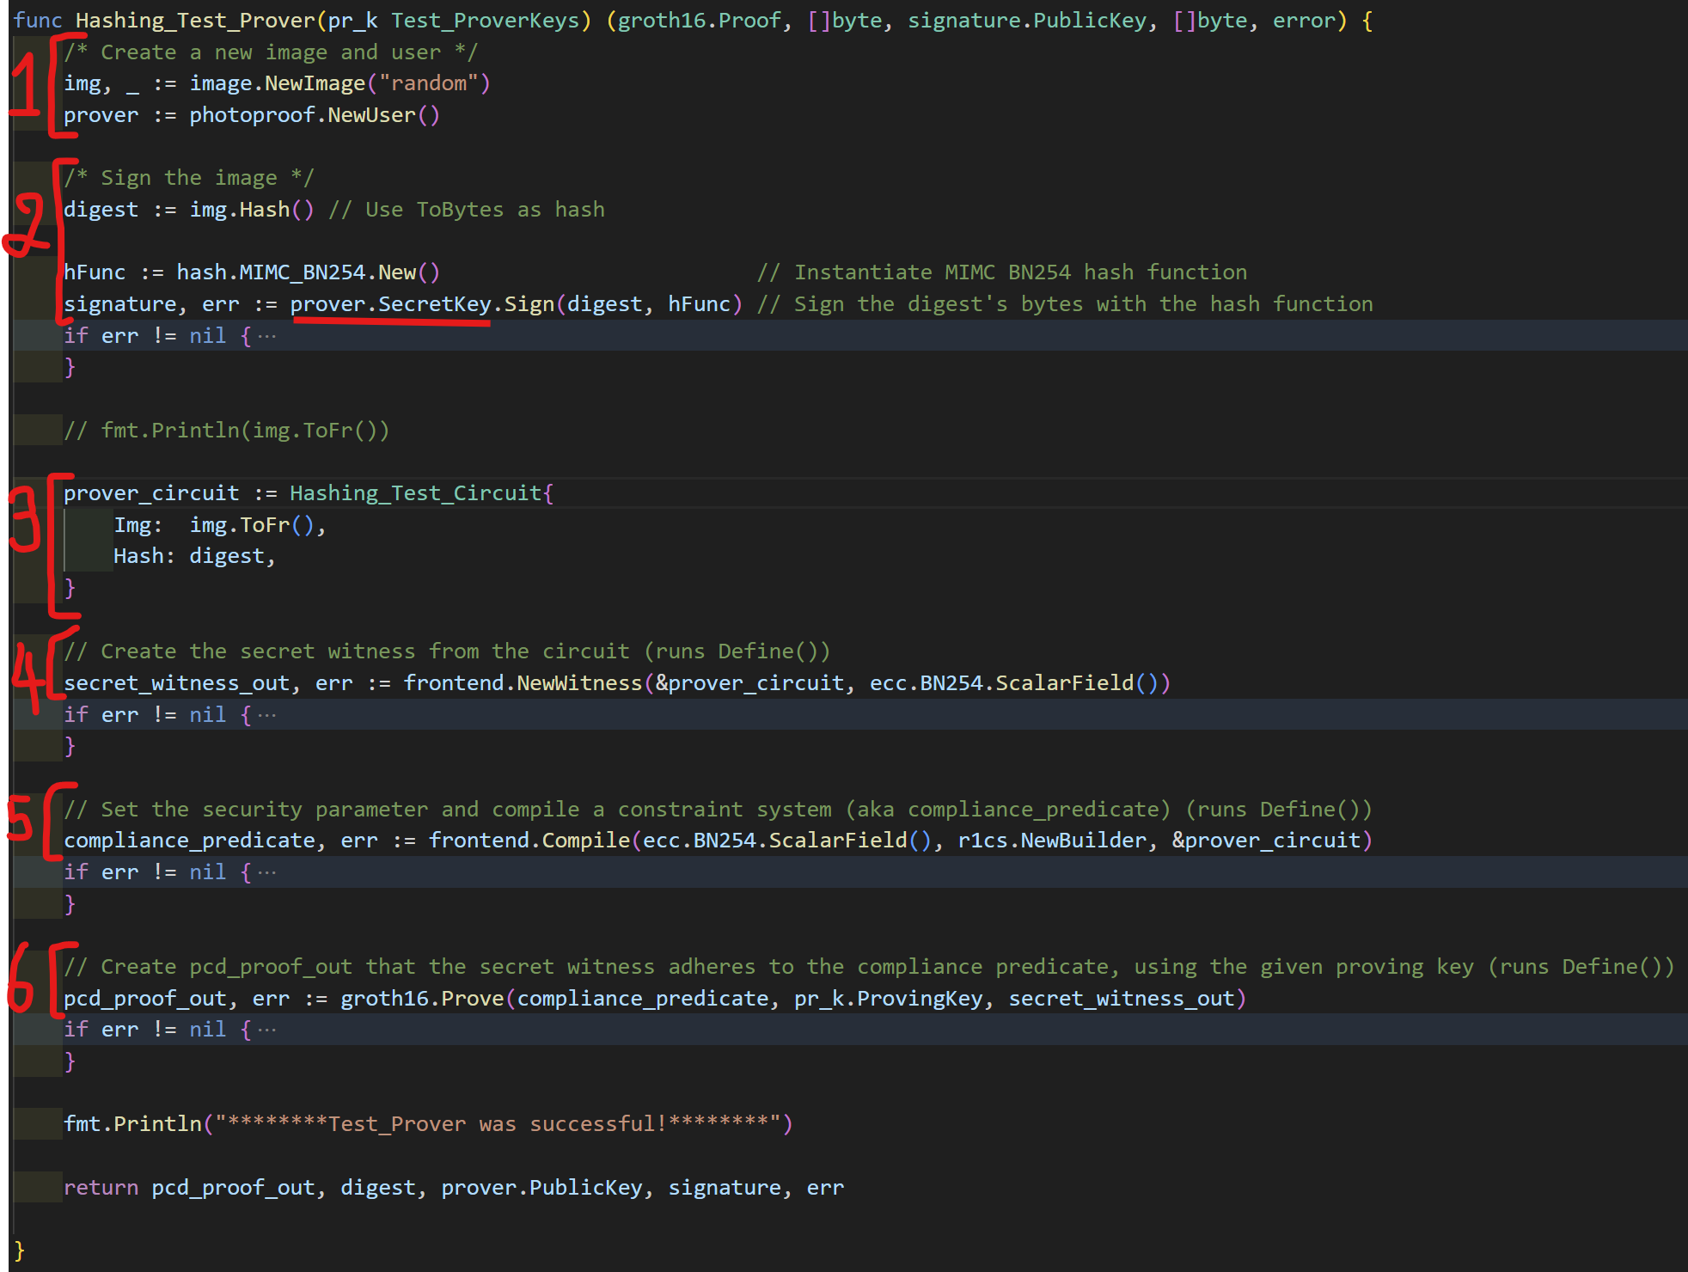
Gnark – Hashing Example
Step 2 – Prover generates a proof.
Create new image and prover
Hash the image
Create a prover’s circuit
Create a new secret witness
Compile the prover’s circuit
Create a proof with the prover’s circuit, witness and the proving key

Slide 20
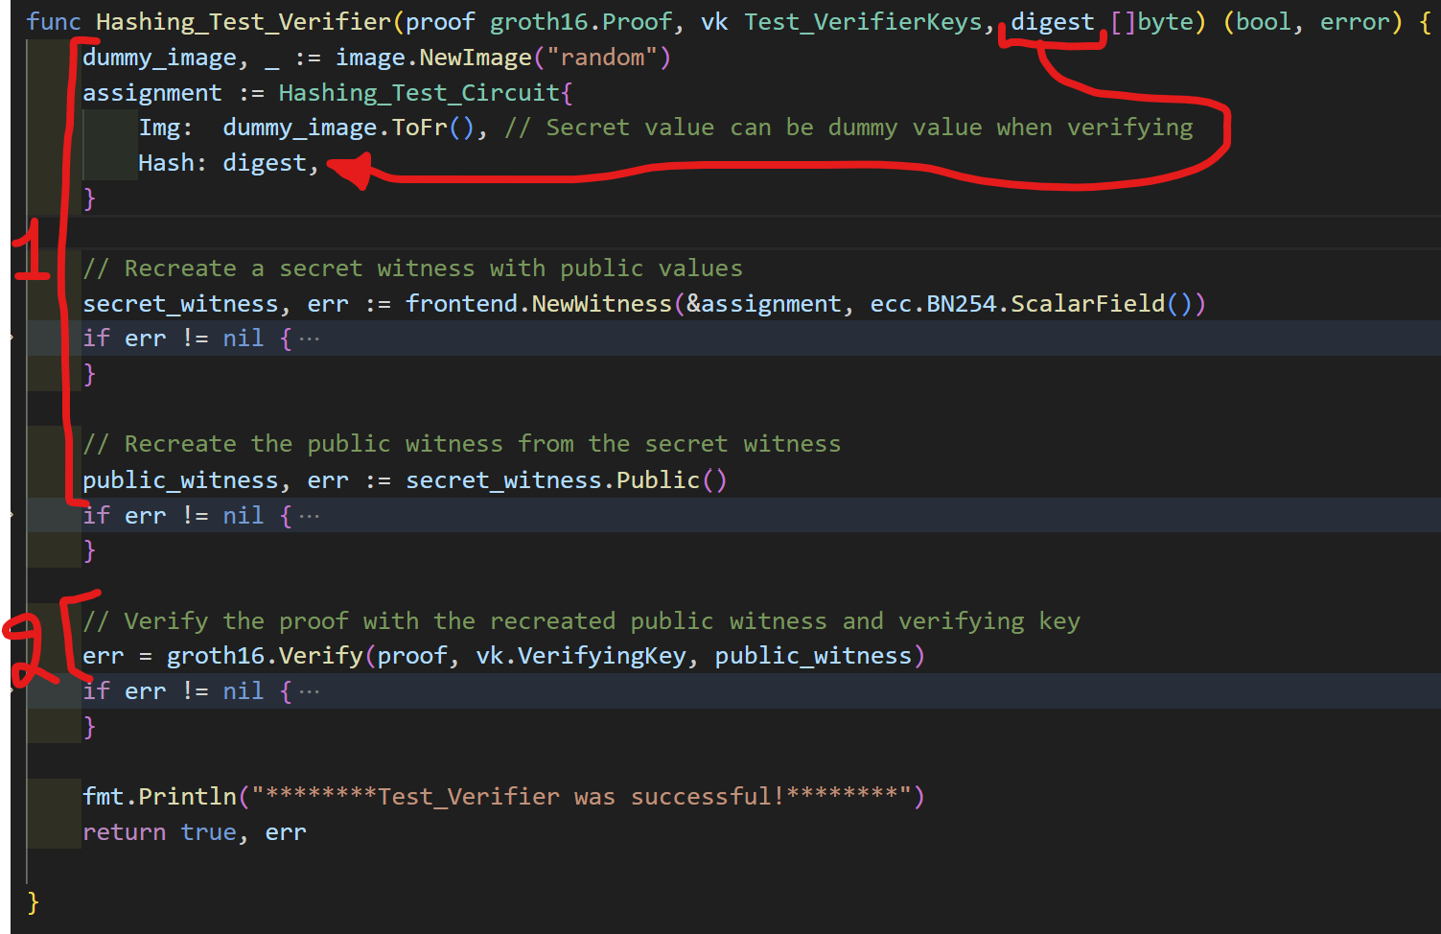
Gnark – Hashing Example
Step 3 – Verifier verifies the proof.
Recreate circuit from the public values and use dummy values for the secret fields.
Verify the given proof using the verifying key and recreated circuit.

Slide 21
Gnark – Limitations
No filesystem or hardware security guarantees
side-channel attack vulnerabilities depend on hardware security & constant time guarantee
Go has no constant time guarantee
Temporary Solution: Administrator & Prover must run in a non-malicious environment (e.g. secure camera, trusted computer systems, etc…)
Notes:
[1] https://docs.gnark.consensys.io/

Slide 22
Images in Modern Society
Images are relied upon in these contexts:
Personal & Social
Legal, Commercial & Scientific
Security & Inteligence
Image forgery leads to:
propaganda, fraud, evidence falsification, extortion
low information quality assessment, social trust & cohesion etc…

Slide 23
Image Forgery & Authentication
How good are nonprofessionals at detecting image forgeries?:
58% accuracy – 2015 ^{[1]}
What about professional image analysts?
low work capacity
more image manipulation tools than forgery detection tools.
Image forgeries are cheaper to produce and harder to detect
Photoshop & CGI
AI
Notes:
[1] V. Schetinger, M. M. Oliveira, R. da Silva, and T. J. Carvalho, “Humans are easily fooled by digital images,” arXiv preprint arXiv:1509.05301, 2015.
[2] DARPA, “DARPA Broad Agency Announcement 15-58: Media Forensics (MediFor),” 2015, https://www.fbo.gov/index?s=opportunity&mode=form&id=bfa29e5f04566fbb961cd773a8a8649f&tab=core&_cview=1.

Slide 24
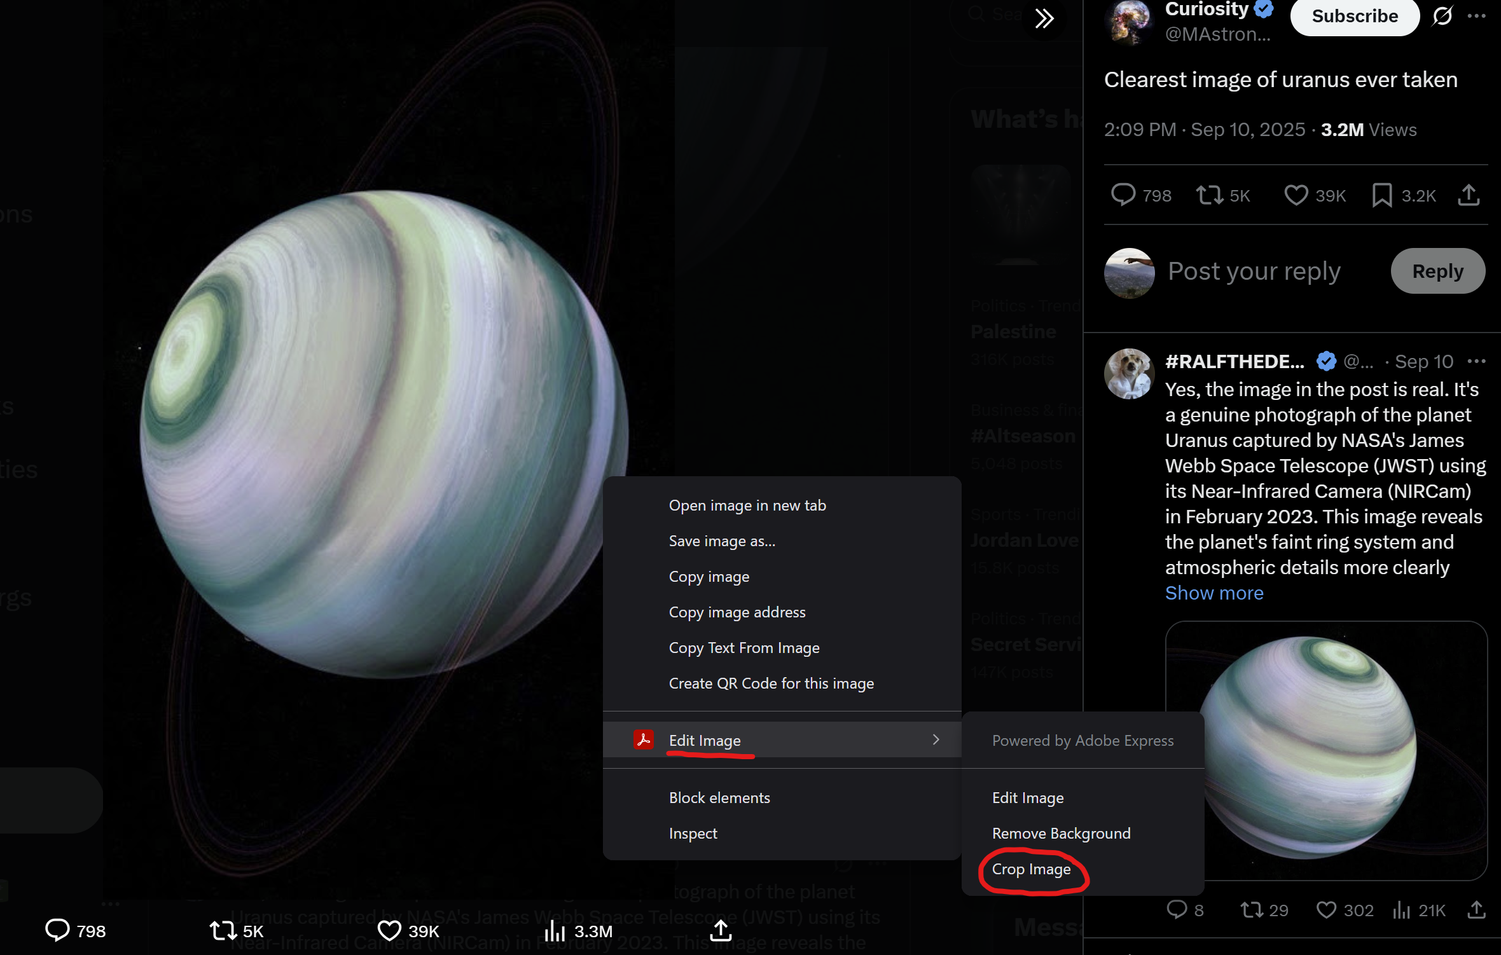
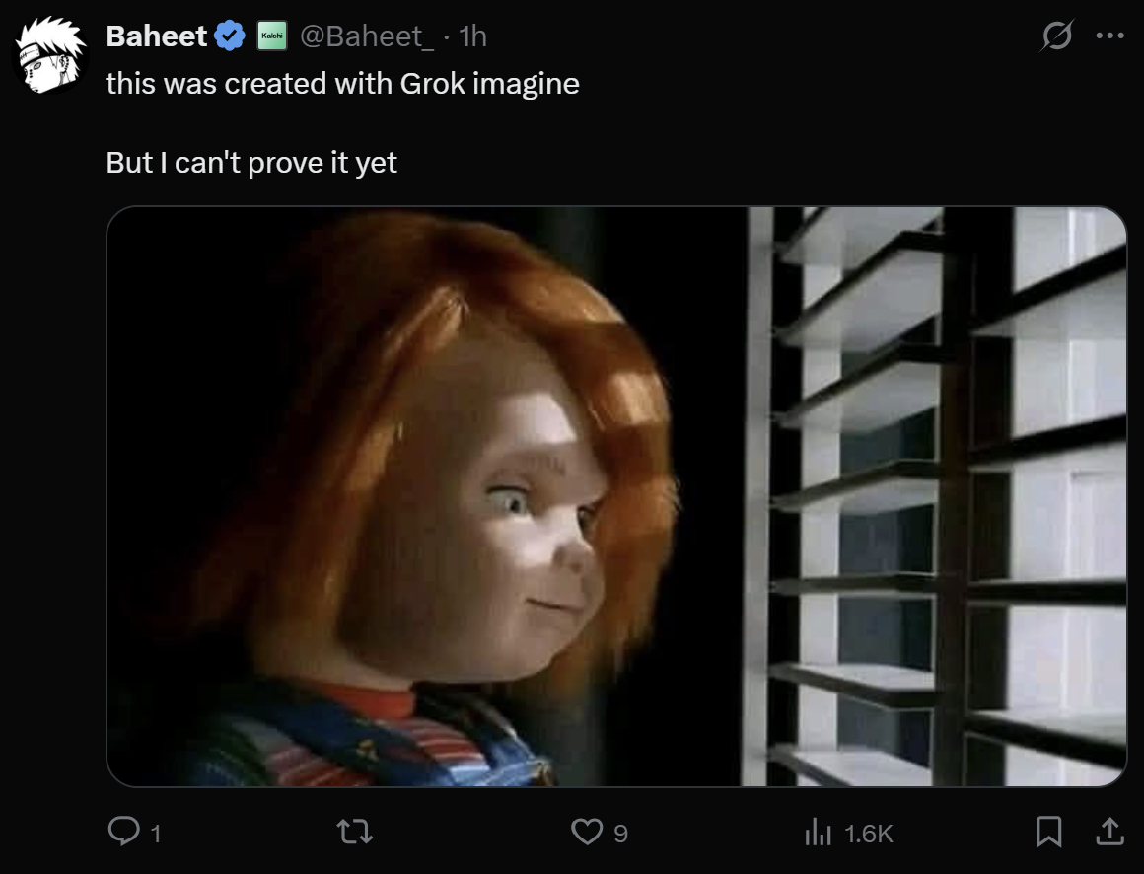
Image Forgery & Authentication

Slide 25
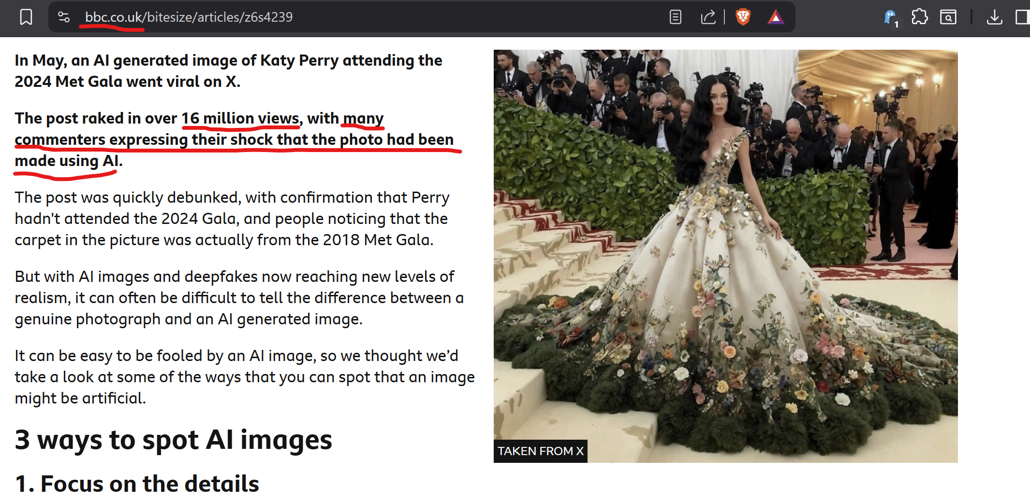
Image Forgery & Authentication

Slide 26
PhotoProof
PhotoProof: Cryptographic Image Authentication for Any Set of Permissible Transformations^{[1]}
by Assa Naveh and Eran Tromer
IEEE Symposium on Security and Privacy, in 2016
Recently improved by Ke-Han Li et. al, in 2023^{[2]}
Leverages zk-SNARKs to prove these properties:
Originality – A given image originates from a Secure Camera
Permissible Provenance – the image has only undergone “Permissible Transformations”
Notes:
[1] A. Naveh and E. Tromer, "PhotoProof: Cryptographic Image Authentication for Any Set of Permissible Transformations," 2016 IEEE Symposium on Security and Privacy (SP), San Jose, CA, USA, 2016, pp. 255-271, doi: 10.1109/SP.2016.23. [2] K. -H. Li, C. -F. Hsu, M. -C. Chang, F. -H. Liu, S. -Y. Chien and W. -C. Chen, "Region-aware Photo Assurance System for Image Authentication," 2023 IEEE 6th International Conference on Multimedia Information Processing and Retrieval (MIPR), Singapore, 2023, pp. 1-6, doi: 10.1109/MIPR59079.2023.00037.
[3] A. Chiesa and E. Tromer, “Proof-carrying data and hearsay arguments from signature cards.” in ICS, vol. 10, 2010, pp. 310–331.
[4] Nir Bitansky, Ran Canetti, Alessandro Chiesa, and Eran Tromer. 2013. Recursive composition and bootstrapping for SNARKS and proof-carrying data. In Proceedings of the forty-fifth annual ACM symposium on Theory of Computing (STOC '13). Association for Computing Machinery, New York, NY, USA, 111–120. https://doi.org/10.1145/2488608.2488623

Slide 27
PhotoProof
Secure Camera: tamperproof camera with protection against Image Injection attacks
Permissible Transformations: image transformations that do not change an image’s authenticity, as defined by Administrator.

Slide 28
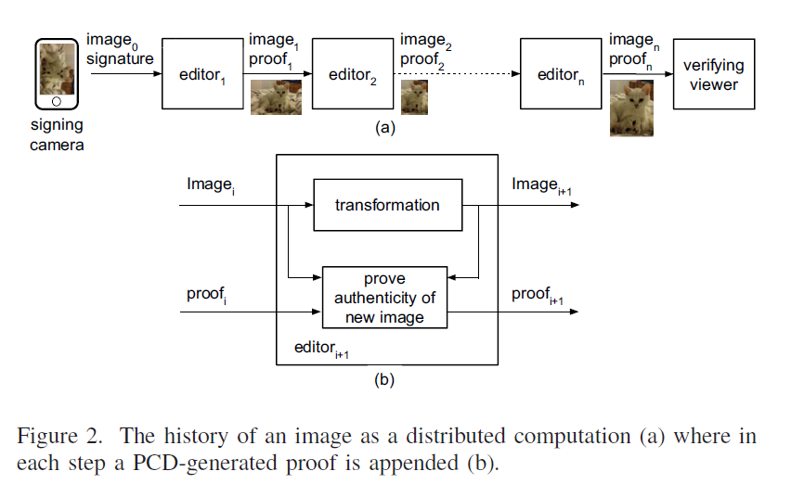
PhotoProof

Slide 29
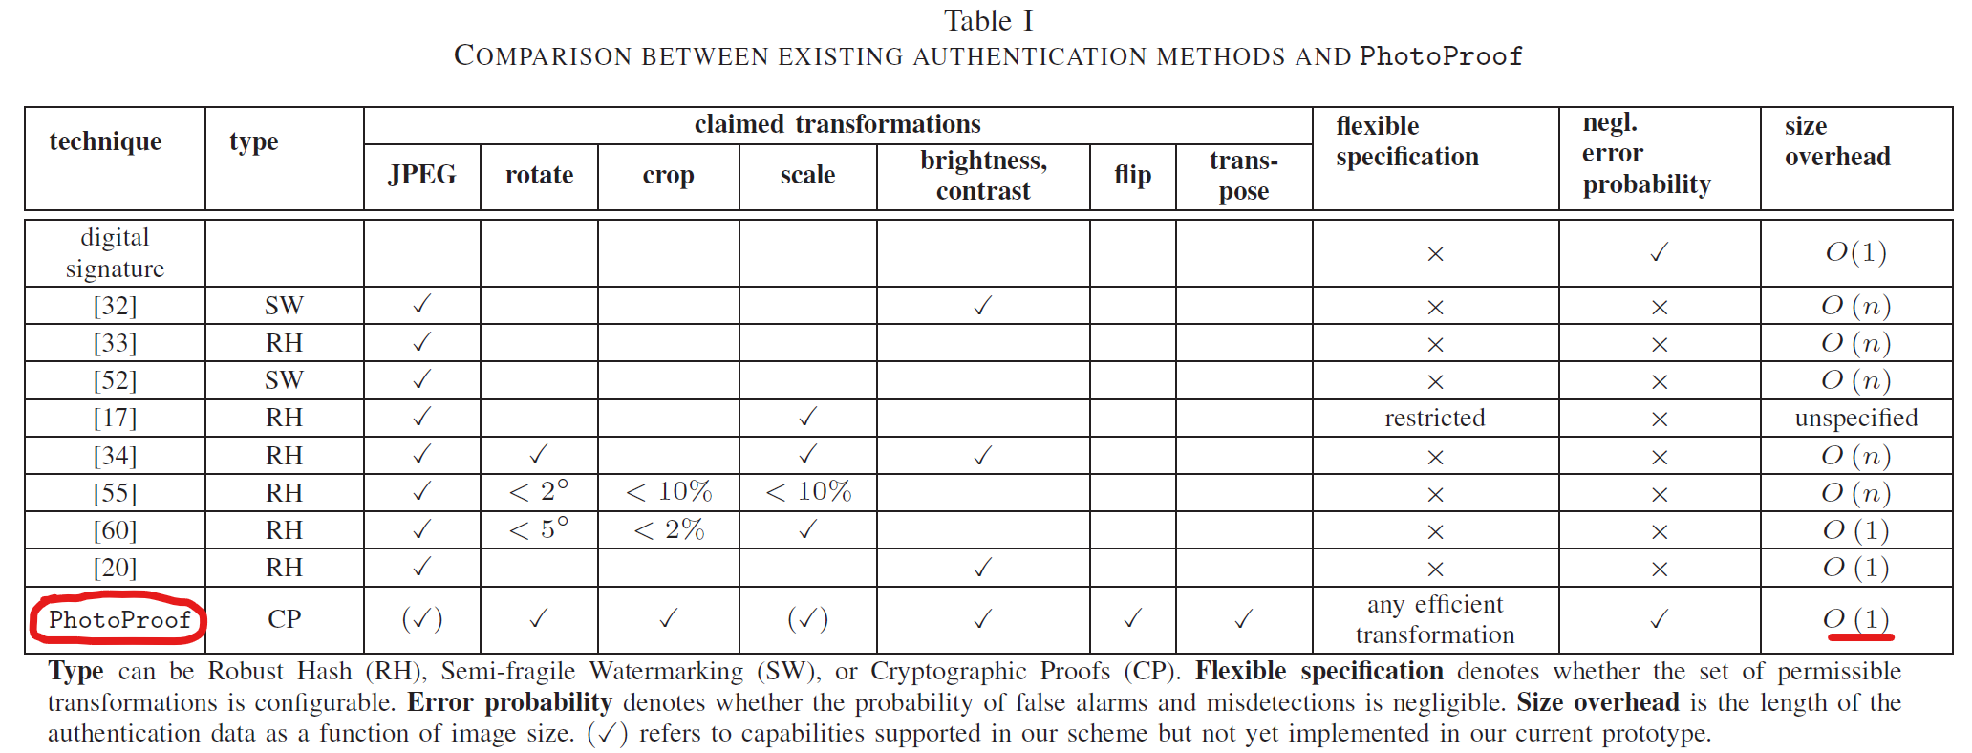
PhotoProof vs. Other Solutions

Slide 30
PhotoProof – Next Steps
Develop a useable tools for generating keys, editing & proving compliance, and viewing images & verifying proofs
Develop Gnark to improve efficiency and security
Develop a Secure Camera

Slide 31
PhotoGnark
By David Mberingabo
Questions?
https://github.com/drakstik/PhotoGnark_ACDF
Notes:
[1] 15-799: Security for Software and Hardware Systems (https://www.cs.cmu.edu/~15799/schedule.html)“

